Slide 1
System model

Slide 2
Advantages and Disadvantages of D.S
Advantages
Resource sharing - Sharing of hardware and software resources.
Openness - Flexibility of using hardware and software of different vendors.
Concurrency - Concurrent processing to enhance performance.
Scalability - Increased throughput by adding new resources.
Fault tolerance - The ability to continue in operation after a fault has occurred.
Disadvantages
Complexity - They are more complex than centralized systems.
Security - More susceptible to external attack.
Manageability - More effort required for system management.
Unpredictability - Unpredictable responses depending on the system organization and network load.

Slide 3
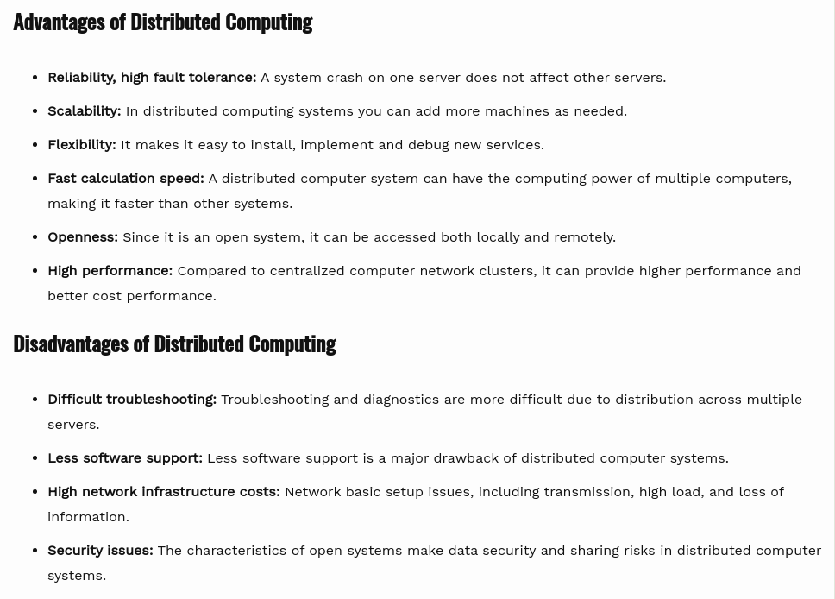

Slide 4
38System models2.1
Outline
System models
Outline
What are the three basic ways to describe Distributed systems? –
Physical models are the most explicit way in which to describe a system; they
capture the hardware composition of a system in terms of the computers (and other
devices, such as mobile phones) and their interconnecting networks.
Architectural models describe a system in terms of the computational and
communication tasks performed by its computational elements; the computational
elements being individual computers or aggregates of them supported by appropriate
network interconnections.
Fundamental models – take an abstract perspective in order to describe solutions to individual issues faced by most distributed systems
interaction models
failure models
security models
Difficulties and threats for distributed systems:
Widely varying modes of use
Wide range of system environments
Internal problems
External threats

Slide 5
Physical models
Baseline physical model – minimal physical model of a distributed system as an extensible set of computer nodes interconnected by a computer network for the required passing of messages.
Three generations of distributed systems
Early distributed systems
10 and 100 nodes interconnected by a local area network
limited Internet connectivity
supported a small range of services e.g.
shared local printers
file servers
email

Slide 6
40System models2.2
* file transfer across the Internet
Internet-scale distributed systems
extensible set of nodes interconnected by a network of networks (the Internet)
Contemporary DS with hundreds of thousands nodes + emergence of:
mobile computing
laptops or smart phones may move from location to location – need for added capabilities (service discovery; support for spontaneous interoperation)
ubiquitous computing
computers are embedded everywhere
cloud computing

Slide 7
41System models2.2 Physical models
* pools of nodes that together provide a given service
Distributed systems of systems (ultra-large-scale (ULS) distributed systems)

Slide 8
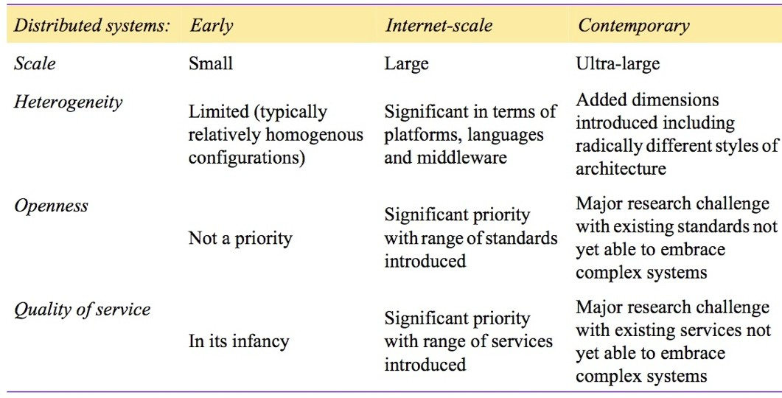
42System models2.2
significant challenges associated with contemporary DS:
Figure 2.1 Generations of distributed systems
Physical models

Slide 9
Architectural Models
Major concerns: make the system reliable, manageable, adaptable and cost- effective
Architectural elements
What are the entities that are communicating in the distributed system?
How do they communicate, or, more specifically, what communication paradigm is used?
What (potentially changing) roles and responsibilities do they have in the overall architecture?
How are they mapped on to the physical distributed infrastructure (what is their placement)?

Slide 10
44System models2.3
Communicating entities
It is helpful to address the question from a system-oriented and a
problem-oriented perspective.
From system perspective: processes
in some cases we can say that:
nodes (sensors)
threads (endpoints of communication)
From programming perspective
objects
computation consists of a number of interacting objects representing natural units of decomposition for the given problem domain
Objects are accessed via interfaces, with an associated interface defi- nition language (or IDL)
Architectural Models

Slide 11
45System models2.3 Architectural Models
components – emerged due to some weaknesses with distributed objects
offer problem-oriented abstractions for building distributed systems
accessed through interfaces
·+ assumptions to components/interfaces that must be present (i.e. making all dependencies explicit and providing a more complete contract for system construction.)
web services
closely related to objects and components
intrinsically integrated into the World Wide Web
using web standards to represent and discover services

Slide 12
46System models2.3
The World Wide Web consortium (W3C):
Architectural Models
Web service is a software application identified by a URI, whose interfaces and bindings are capable of being defined, described and discovered as XML artefacts. A Web service supports direct interactions with other software agents using XML-based message exchanges via Internet-based protocols.
objects and components are often used within an organization to develop tightly coupled applications
web services are generally viewed as complete services in their own right

Slide 13
47System models2.3
Communication paradigms
Interprocess communication – Interprocess communication refers to the relatively low-level support for communication between processes in distributed systems, including message-passing primitives, direct access to the API offered by Internet protocols (socket programming)
and support for multicast communication.
Remote invocation represents the most common communication paradigm in distributed systems, covering a range of techniques based on a two-way exchange between communicating entities in a distributed system and resulting in the calling of a remote operation, procedure or method
Request-reply protocols – a pattern with message-passing service to support client-server computing
Architectural Models

Slide 14
48System models2.3 Architectural Models
Remote procedure call (RPC)
procedures in processes on remote computers can be called as if they are proce- dures in the local address space
supports client-server computing with servers offering a set of operations through a service interface and clients calling these operations directly as if they were available locally
–– What type of transparency do RPC systems offer?
RPC systems offer (at a minimum) access and location transparency
Remote method invocation (RMI)
strongly resemble RPC but in a world of distributed objects
tighter integration into object-orientation framework

Slide 15
49System models2.3
In RPC and RMI –
senders-receivers of messages
coexist at the same time
are aware of each other’s identities
Indirect communication
Senders do not need to know who they are sending to ( space uncoupling)
Senders and receivers do not need to exist at the same time ( time uncoupling)
Key techniques in indirect communication:
Group communication
Publish-subscribe systems:
Architectural Models

Slide 16
50System models2.3 Architectural Models
(sometimes also called distributed event-based systems)
publishers distribute information items of interest (events) to a similarly large number of consumers (or subscribers)
Message queues:
(publish-subscribe systems offer a one-to-many style of communication), message queues offer a point-to-point service
producer processes can send messages to a specified queue
consumer processes can
receive messages from the queue or
be notified
Tuple spaces (also known as generative communication):
processes can place arbitrary items of structured data, called tuples, in a persistent tuple space

Slide 17
51System models2.3 Architectural Models
other processes can either read or remove such tuples from the tuple space by specifying patterns of interest
readers and writers do not need to exist at the same time (Since the tuple space is persistent)
Distributed shared memory (DSM):
– abstraction for sharing data between processes that do not share physical memory

Slide 18
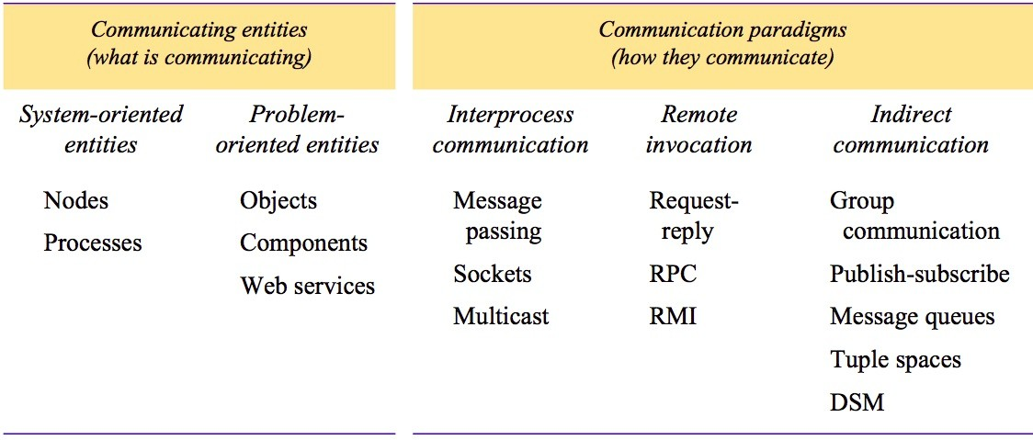
52System models2.3 Architectural Models
Figure 2.2 Communication entities and communication paradigms

Slide 19
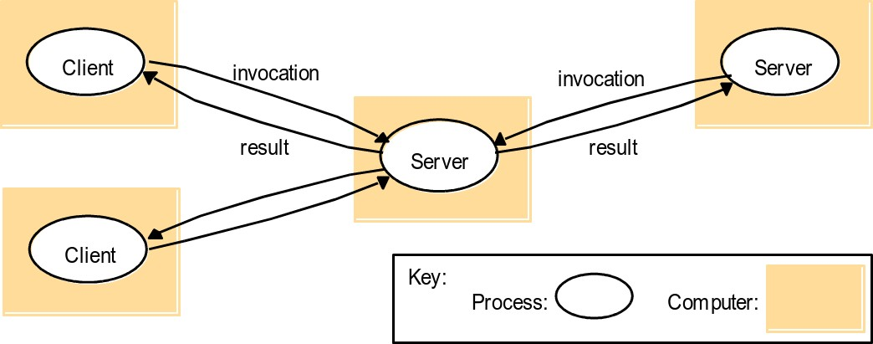
53System models2.3
Roles and responibilities
Client-server
Figure 2.3 Clients invoke individual servers
Architectural Models

Slide 20
Client-server: This is the architecture that is most often cited when distributed systems
are discussed. It is historically the most important and remains the most widely
employed. Figure 2.3 illustrates the simple structure in which processes take on the roles
of being clients or servers. In particular, client processes interact with individual server
processes in potentially separate host computers in order to access the shared resources
that they manage.
Servers may in turn be clients of other servers, as the figure indicates. For
example, a web server is often a client of a local file server that manages the files in
which the web pages are stored. Web servers and most other Internet services are clients
of the DNS service, which translates Internet domain names to network addresses.
Another web-related example concerns search engines, which enable users to look up
summaries of information available on web pages at sites throughout the Internet.

Slide 21
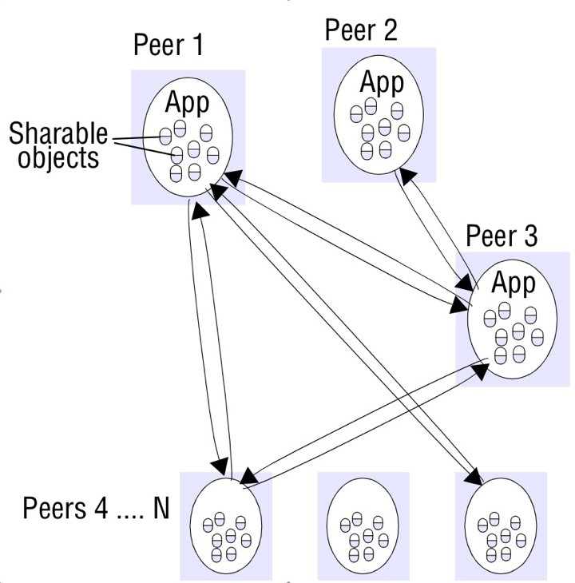
54System models2.3
Peer-to-peer
Figure 2.4a Peer-to-peer architecture
Architectural Models
– same set of interfaces to each other

Slide 22
Peer-To-Peer Model
A peer-to-peer (P2P) distributed system architecture doesn’t have any specific clients or servers. A P2P network is a distributed system of machines called nodes. All nodes can perform the role of client and server either concurrently or at different points in time. The model is inherent in the name itself in a P2P network, each machine is an equal peer, rather than being a client or a server.
P2P networks become popular after the release of file-sharing services like the music-sharing site Napster. The idea of P2P gained a kind of cult status because systems could operate independently of any centralized control. Today, outside of block-chain, file sharing protocol BitTorrent is probably the biggest and most recognizable name associated with P2P networks
.
A peer-to-peer (P2P) network in which interconnected nodes ("peers") share resources amongst each other without the use of a centralized administrative system. For better understanding go to “Wikipedia”.
https://www.geeksforgeeks.org/what-is-p2ppeer-to-peer-process/

Slide 23
Placement • The final issue to be considered is how entities such as objects or services map on to the underlying physical distributed infrastructure which will consist of a potentially large number of machines interconnected by a network of arbitrary
complexity.
Placement is crucial in terms of determining the properties of the distributed system, most obviously with regard to performance but also to other aspects, such as reliability and security.

Slide 24
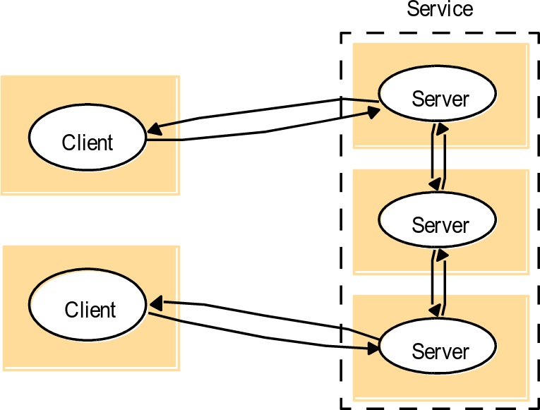
55System models2.3
Placement
crucial in terms of determining the DS properties:
performance
reliability
security
Architectural Models
Possible placement strategies:
mapping of services to multiple
servers
Figure 2.4b A service provided by multi- ple servers
mapping distributed objects between servers, or
replicating copies on several hosts
more closely coupled multiple-servers – cluster

Slide 25
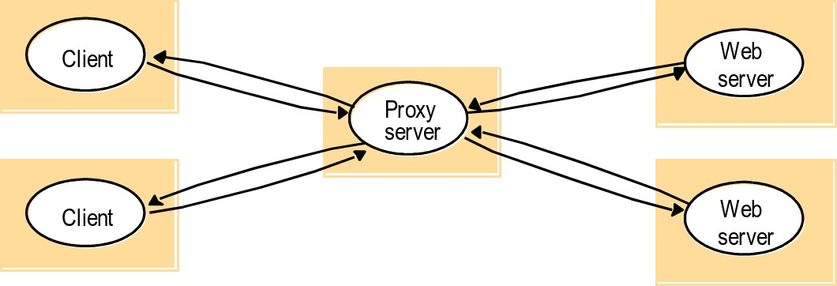
56System models2.3
caching
Architectural Models
– A cache is a store of recently used data objects that is closer to one client or a particular set of clients than the objects themselves
Figure 2.5 Web proxy server

Slide 26
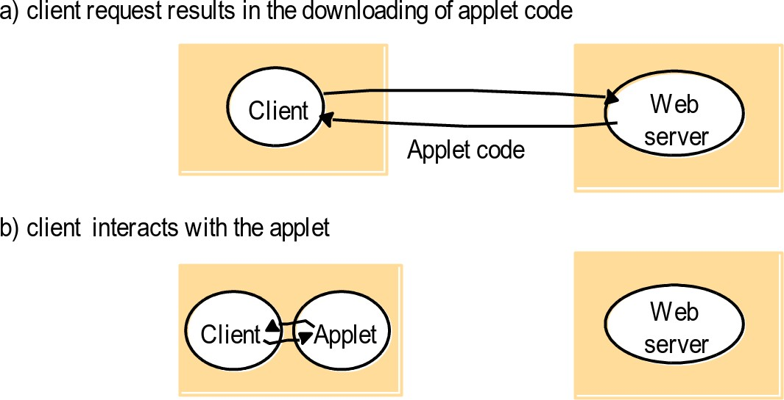
57System models2.3
mobile code
– Applets are an example of mobile code Figure 2.6 Web Applets
Architectural Models
– yet another possibility – push model: server initiates interaction (e.g. on information updates on it)

Slide 27
58System models2.3
mobile agents
Architectural Models
– Mobile agent – running program (including both code and data) that travels from one computer to another in a network carrying out a task on someone’s behalf (e.g. collecting information), and eventually re- turning with the results.
could be used for
software maintenance
collecting information from different vendors’ databases of prices
Possible security threats with mobile code and mobile agents...

Slide 28
59System models2.3
Architectural patterns
Layering
The concept of layering is a familiar one and is closely related to abstraction. In a layered approach, a complex system is partitioned into a number of layers, with a given layer making use of the services offered by the layer below. A given layer therefore offers a software abstraction, with higher layers being unaware of
implementation details, or indeed of any other layers beneath them.
Layered approach – complex system partitioned into a number of layers:
vertical organisation of services
given layer making use of the services offered by the layer below
software abstraction
higher layers unaware of implementation details, or any other layers beneath them
Architectural Models

Slide 29
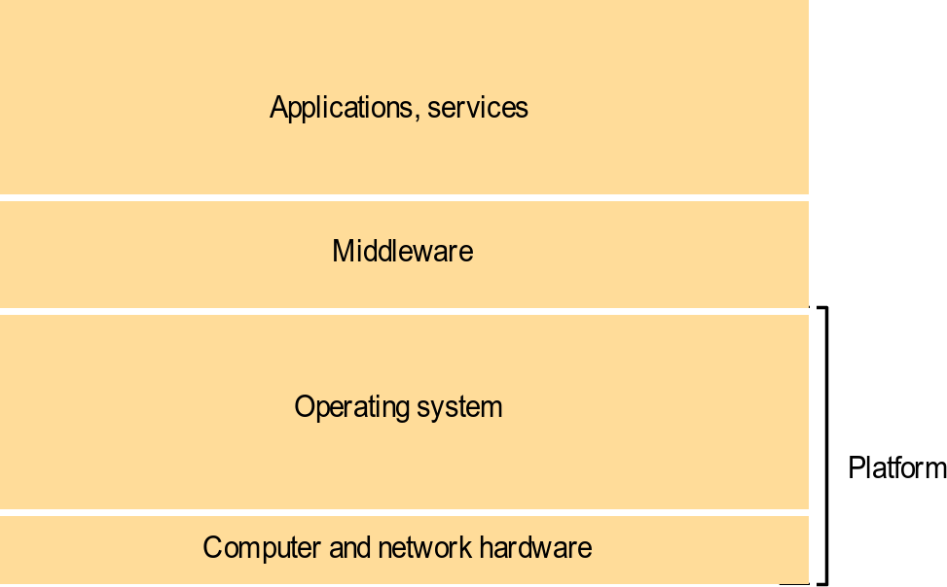
60System models2.3 Architectural Models
Platform and Middleware
Figure 2.7 Software and hardware service layers in distributed systems
A platform for distributed systems and applications consists of the lowest-level hardware and software layers.

Slide 30
61System models 2.3 Architectural Models
Middleware – a layer of software whose purpose is to mask hetero- geneity and to provide a convenient programming model to application programmers.

Slide 31
62System models2.3
Tiered architecture
Tiering is a technique to organize functionality of a given layer and place this functionality into appropriate servers and, as a secondary consideration, on to physical nodes
Example: two-tier and three-tier architecture
functional decomposition of a given application, as follows:
presentation logic
application logic
data logic

Slide 32
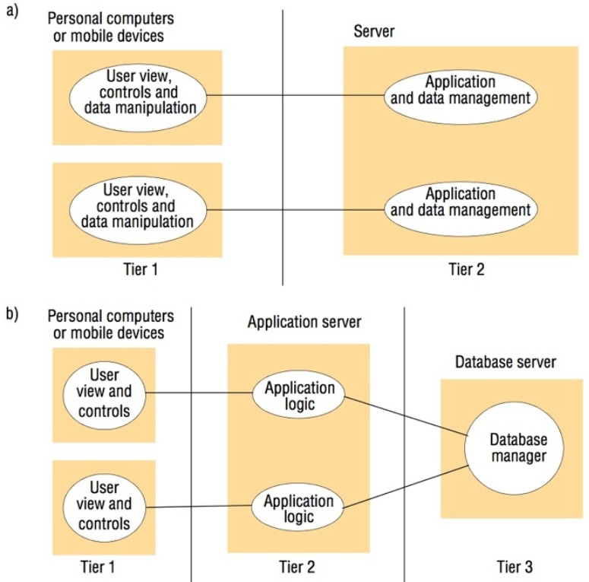
63System models2.3
Architectural Models
Figure 2.8 Two-tier and three-tier architectures
three aspects par- titioned into two processes
(+) low latency
(-) splitting applica- tion logic
(+) one-to-one map- ping from logical elements to physical servers
(-) added complexity, network traffic and la- tency

Slide 33
64System models2.3 Architectural Models
AJAX (Asynchronous Javascript And XML) – a way to create interactive, partially/selectively-updatable webpages
extension to the standard client-server style of interaction in WWW
– Javascript forntend and server-based backend
Figure 2.9 AJAX example: soccer score updates
, ,
newAjax . Request ( ’s c o r e s.php?game=Arsenal:L i v e r p o o l’
{ on Success : update Score } ) ;
f u n c t i o nupdate Score ( r e q u e s t ) {
. . . . .
( r e q u e s tc o n t a i n sthes t a t eoftheAjaxr e q u e s ti n c l u d i n gthereturnedr e s u l t
,
.
Ther e s u l ti sparsedtoo b t a i nsomet e x tg i v i n gthescore , whichi sused toupdatether e l e v a n tp o r t i o nofthecurrentpage . )
. . . . .
}
z
(two-tier architecture)

Slide 34
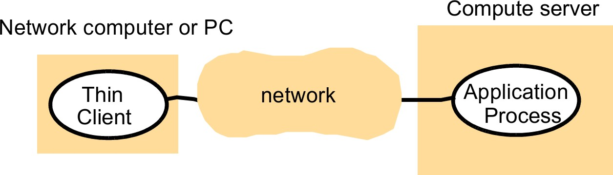
65System models2.3 Architectural Models
Thin clients
enabling access to sophisticated networked services (e.g. cloud services) with few assumptions to client device
software layer that supports a window-based user interface (local) for executing remote application programs or accessing services on remote computer
Figure 2.10 Thin clients and computer servers
Concept led to Virtual Network Computing (VNC) – VNC clients accessing VNC servers using VNC protocol

Slide 35
66System models2.3
Other commonly occurring patterns
proxy pattern
designed to support location transparency in RPC or RMI
proxy created in local address space, with same interface as the remote object
brokerage in web services
supporting interoperability in potentially complex distributed infrastructures
service provider, service requestor and service broker
brokerage reflected e.g. in registry in Java RMI and naming service in CORBA
Architectural Models

Slide 36
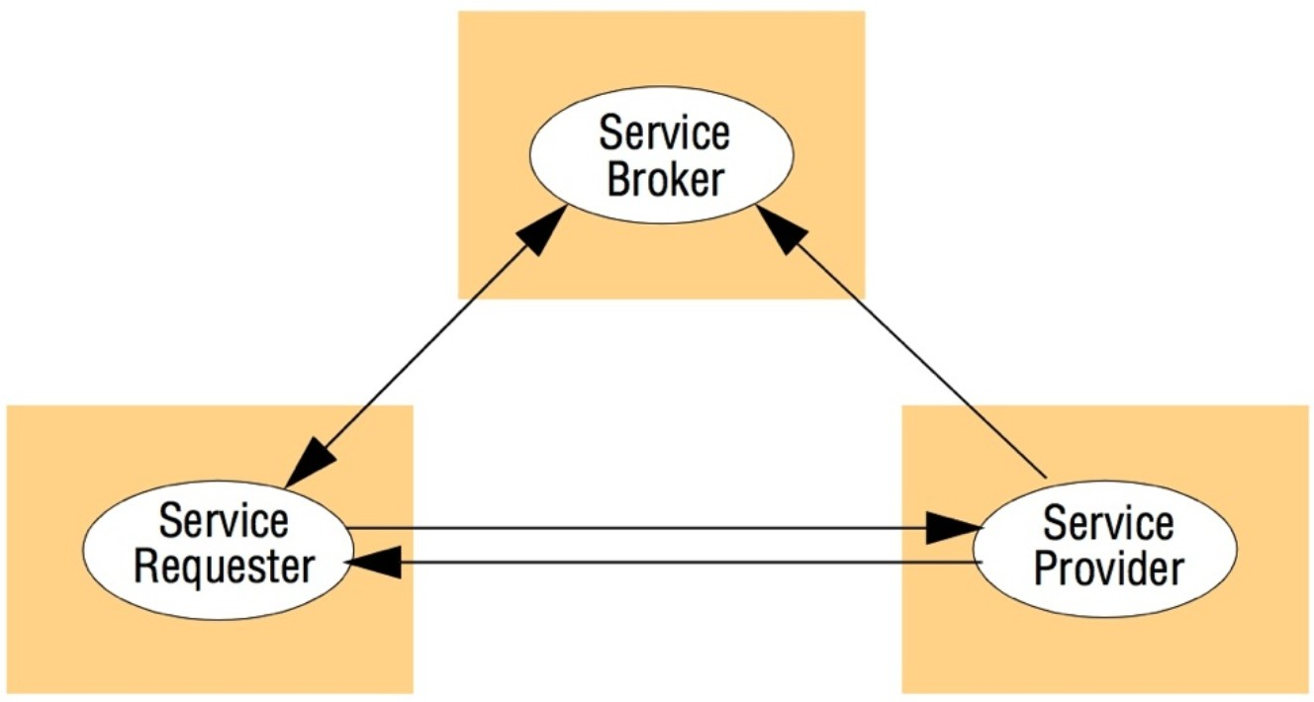
67System models2.3
Figure 2.11 The web service architectural pattern
Architectural Models
Reflection pattern
a means of supporting both:
introspection (the dynamic discovery of properties of the system)
intercession (the ability to dynamically modify structure or behaviour)
used e.g. in Java RMI for generic dispatching
ability to intercept incoming messages or invocations

Slide 37
68System models2.3 Architectural Models
dynamically discover interface offered by a given object
discover and adapt the underlying architecture of the system
2.3.3 Associated middleware solutions
The task of middleware is to provide a higher-l development of distributed systems and, through layering, to abstract over heterogene- ity in the underlying infrastructure to promote interoperability and portability.

Slide 38
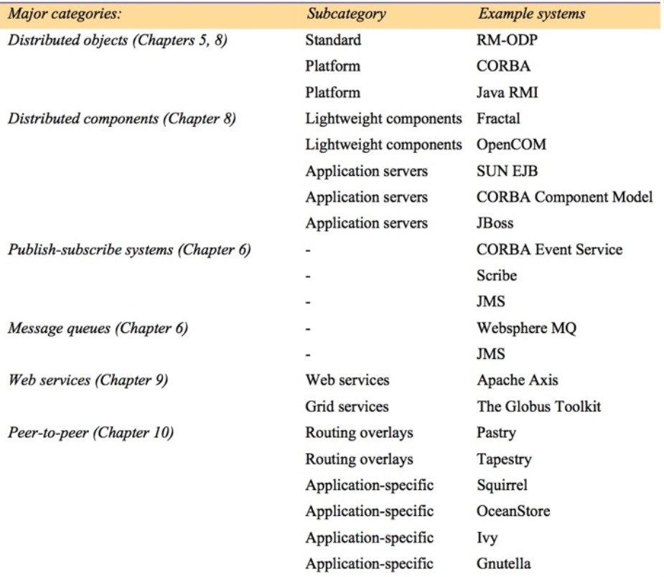
69System models2.3
Categories of middleware
Figure 2.12 Categories of middleware
Architectural Models

Slide 39
70System models2.3
Limitations of middleware
Some communication-related functions can be completely and reliably imple- mented only with the knowledge and help of the application standing at the end points of the communication system.
Example: e-mail transfer need another layer of fault-tolerance that even TCP can- not offer
Architectural Models

Slide 40
71System models2.4
Fundamental models
Fundamental models
What is:
Interaction model?
Failure model?
Security model?
Interaction model
processes interact by passing messages –
communication (information flow) and
coordination (synchronization and ordering of activities) between processes

Slide 41
72System models2.4 Fundamental models
communication takes place with delays of considerable duration
accuracy with which independent processes can be coordinated is limited by these delays
and by difficulty of maintaining the same notion of time across all the computers in a distributed system
Behaviour and state of DS can be described by a distributed algorithm:
steps to be taken by each interacting process
•+ transmission of messages between them
State belonging to each process is completely private

Slide 42
Fundamental models
73System models2.4
Performance of communication channels
latency – delay between the start of message’s transmission from one process and the beginning of receipt by another
bandwidth of a computer network – the total amount of information that can be transmitted over it in a given time
Jitter – the variation in the time taken to deliver a series of messages
Computer clocks and timing events
clock drift rate – rate at which a computer clock deviates from a perfect refer- ence clock

Slide 43
Fundamental models
74System models2.4
Two variants of the interaction model
Synchronous distributed systems:
The time to execute each step of a process has known lower and upper bounds
Each message transmitted over a channel is received within a known bounded time
Each process has a local clock whose drift rate from real time has a known bound
Asynchronous distributed systems:
No bounds on:
Process execution speeds
Message transmission delays
Clock drift rates

Slide 44
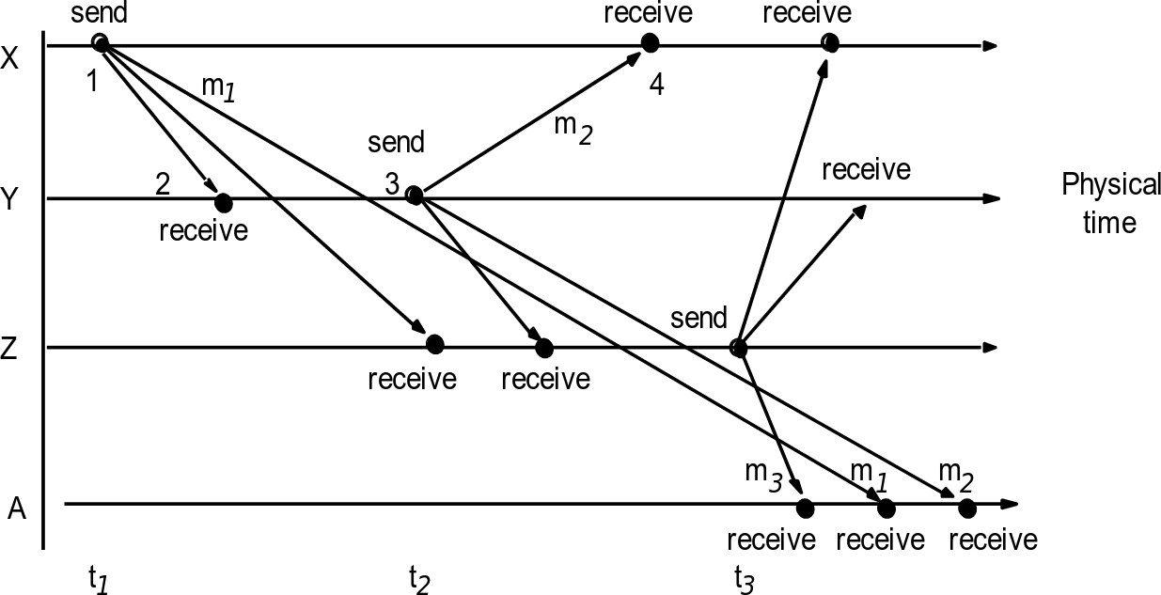
Fundamental models
75System models2.4
Event ordering
Figure 2.13 Real-time ordering of events
Logical time – based on event ordering

Slide 45
Fundamental models
76System models2.4
Failure model
faults occur in:
any of the computers (including software faults)
or in the network
Failure model defines and classifies the faults
Omission failures
process or communication channel fails to perform actions it is supposed to do
Process omission failures
cheaf omission failure of a process is to crash
crash is called fail-stop if other processes can detect certainly that the pro- cess has crashed

Slide 46
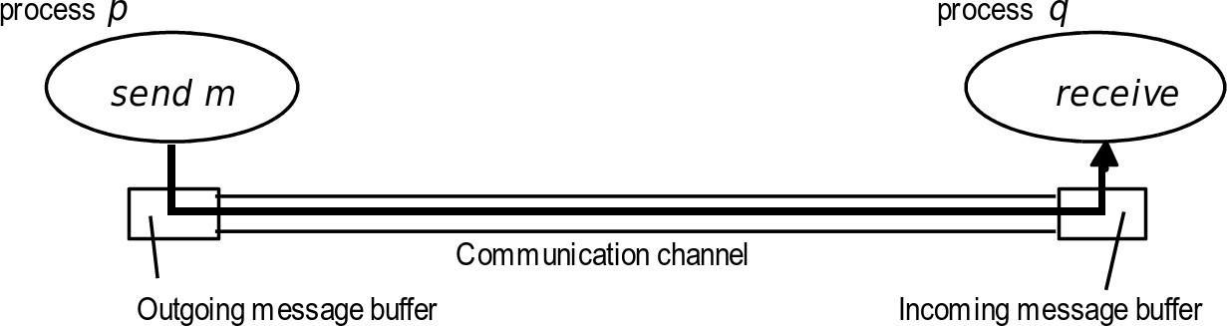
Fundamental models
77System models2.4
Communication omission failures
communication channel does not transport a message from message buffer to q’s incoming message buffer
p’s outgoing
known as dropping messages
send-omission failures
receive-omission failures
channel-omission failures
Figure 2.14 Processes and channels
All failures so far: benigh failures

Slide 47
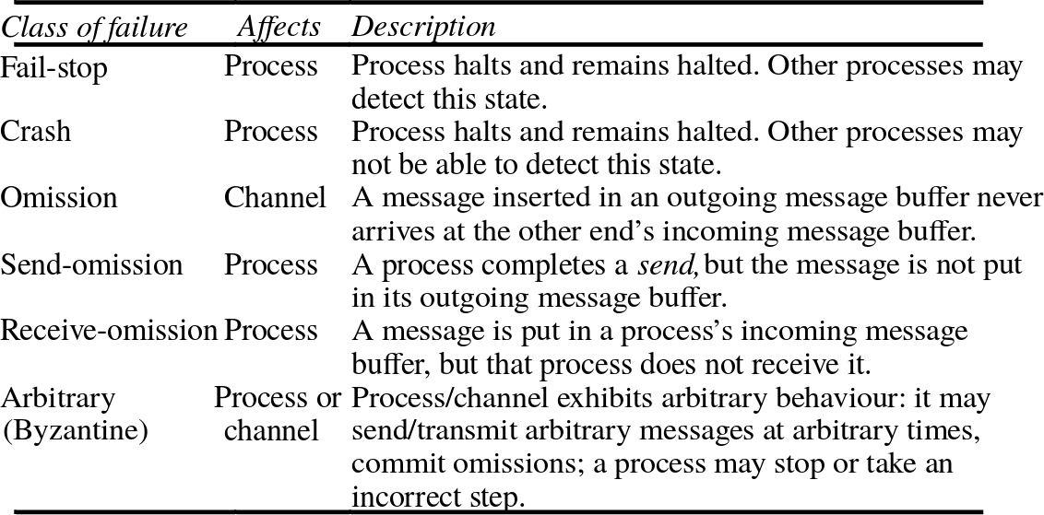
78System models2.4 Fundamental models
Arbitrary failures
arbitrary or Byzantine failure is used to describe the worst possible failure se-
mantics, in which any type of error may occur Figure 2.15 Omission and arbitrary failures

Slide 48
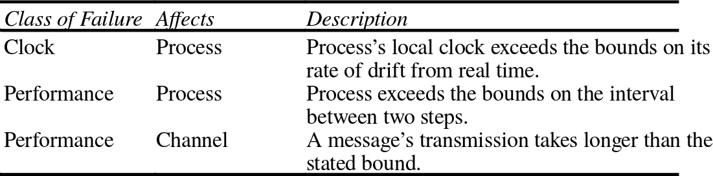
Fundamental models
79System models2.4
Timing failures
applicable in synchronous distributed systems Figure 2.16 Timing failures
Masking failures
knowledge of the failure can enable a new service to be designed to mask the failure of the components on which it depends

Slide 49
Fundamental models
80System models2.4
Reliability of one-to-one communication
reliable communication:
Validity: Any message in the outgoing message buffer is eventually deliv- ered to the incoming message buffer
Integrity: The message received is identical to one sent, and no messages are delivered twice

Slide 50
Fundamental models
81System models2.4
Security model
modular nature of distributed systems and their openness exposes them to attack by
both external and internal agents
Security model defines and classifies attack forms,
providing a basis for the analysis of threats
basis for design of systems that are able to resist them
the security of a distributed system can be achieved by securing the processes and the channels used for their interactions and by protecting the objects that they encapsulate against unauthorized access.

Slide 51
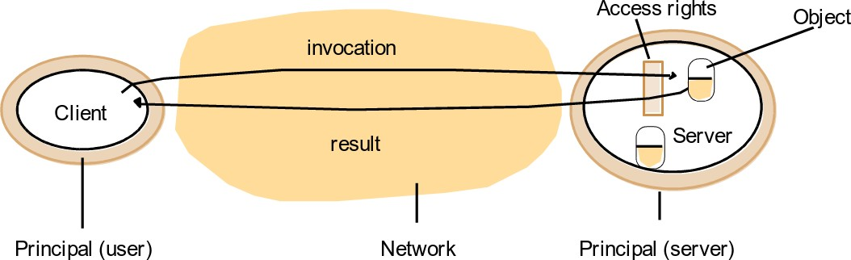
82System models2.4 Fundamental models
Protecting objects
Users with access rights
association of each invocation and each result with the authority on which it is issued
– such an authority is called a principal
* principal may be a user or a process
Figure 2.17 Objects and principals

Slide 52
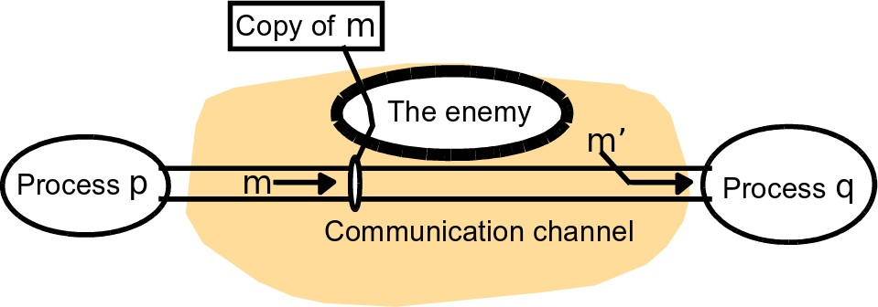
Fundamental models
83System models2.4
Securing processes and their interactions
securing communications over open cahnnels
open service interfaces
The enemy
or also: adversary
Figure 2.18 The enemy

Slide 53
Fundamental models
84System models2.4
Threats to processes
lack of knowledge of true source of a message
problem both to server and client side
example: spoofing a mail server
Threats to communication channels
threat to the privacy and integrity of messages
can be defeated using secure channels

Slide 54
Fundamental models
85System models2.4
Defeating security threats
Cryptography and shared secrets
Cryptography is the science of keeping messages secure
Encryption is the process of scrambling a message in such a way as to hide its contents
Authentication
based on shared secrets authentication of messages – proving the identities sup- plied by their senders

Slide 55
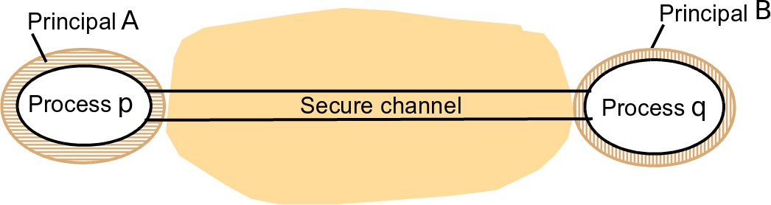
Fundamental models
86System models2.4
Secure channels
Figure 2.19 Secure channels
Properties of a secure channel:
Each of the processes knows reliably the identity of the principal on whose behalf the other process is executing
A secure channel ensures the privacy and integrity (protection against tamper- ing) of the data transmitted across it

Slide 56
87System models2.4 Fundamental models
Each message includes a physical or logical timestamp to prevent messages from being replayed or reordered
Other possible threats from an enemy
Denial of service:
the enemy interferes with the activities of authorized users by making ex- cessive and pointless invocations on services or message transmissions in a network, resulting in overloading of physical resources (network band- width, server processing capacity)
Mobile code:
execution of program code from elsewhere, such as the email attachment etc.

Slide 57
Fundamental models
88System models2.4
The uses of security models
Security analysis involves
the construction of a threat model:
listing all the forms of attack to which the system is exposed
an evaluation of the risks and consequences of each
End of week 2

